Slide 1
Urry Group Weekly Update
Thursday, July 7th

Slide 2
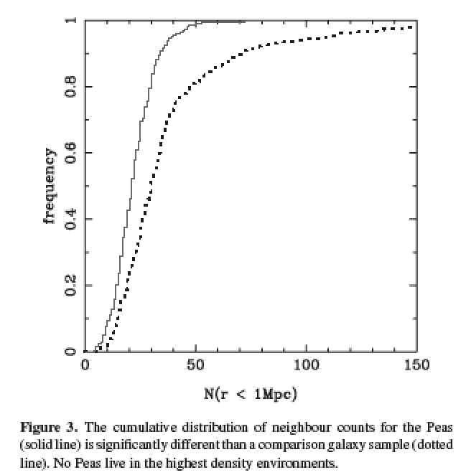
Cardamone et al. 2009
Projected density around Peas vs. sample matched in luminosity and redshift
Looked within projected 1Mpc, and imag > -20.5
Notes:
Projected density around Peas vs. sample matched in luminosity and redshift
Looked within 1Mpc, and imag > -20.5
Peas lie in lower density regions than typical gal at same i-band luminosity
KS test 8 sigma
Median environmental density less than 2/3rds normal galaxies

Slide 3
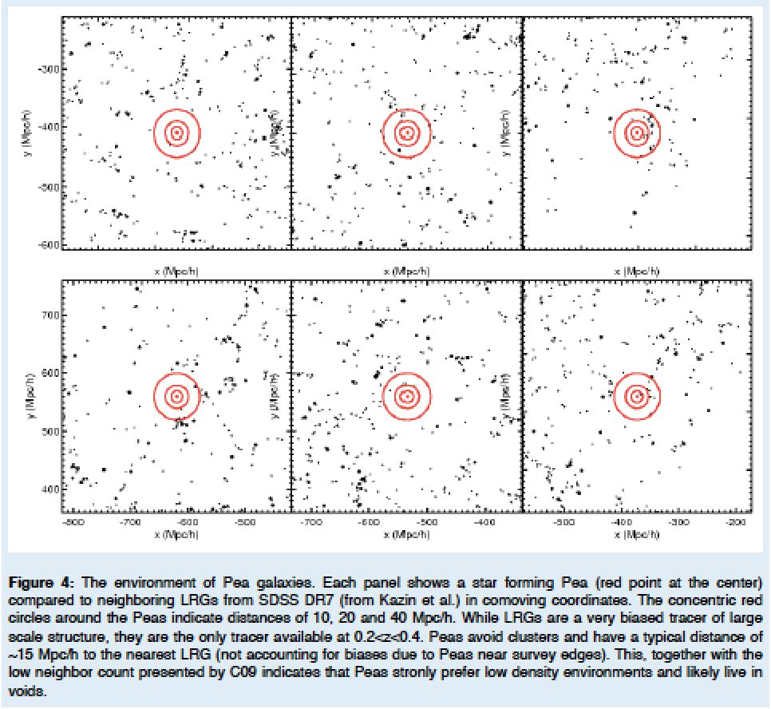
Kevin’s HST SNAP proposal / ~15 Mpc/h to nearest DR7 LRGs
Notes:
(10,20 & 40 Mpc/h) – red circles
Strongly prefer low density environments. . . .

Slide 4
Mapping Environment of Green Peas
Original idea – match peas to a Mock Universe
Looking at abundance matching
e.g., distance to 5th nearest neighbor (W/in Mstar)
e.g., distribution of Neighbors within 1/5 Mpc

Slide 5
Searching for Pea Neighbors
Starting with the original sample of 80 peas, looking within 50 Mpc projected
Neighbors found with specz 427
Neighbors in photometric catalog 120595
Neighbors found with photo redshift est 20743
Neighbors found w/ photoz in 1sig of pea z 9844
+ -> photo error class 1 3560
*** only a handful (35) remain if looking within 5 Mpc… ***

Slide 6
To Dos:
Compute 3D distance between a pea & a neighbor using redshifts (lumdist.pro)
Find a selection sample for 5th nearest neighbor . . .
Finalize DR12 selection of peas for follow-ups (still cleaning), figure out how to avoid galaxies!
Start learning compute.sciserver.org (Read in a catalog from casjobs)

Slide 7
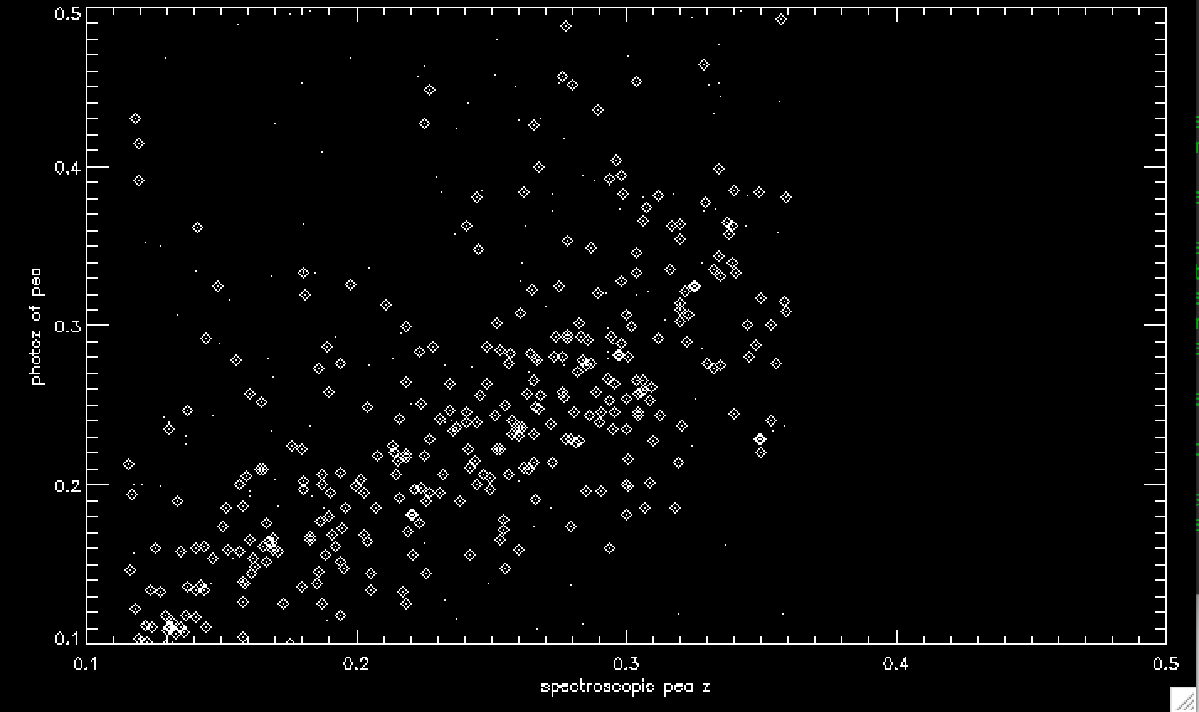
Photo-z catalog compared to spec for the DR12 Peas

Slide 8
Search for Peas in DR12
Original Sample was 251 in color, 80 SF spectra (9 stripe 82)
DR12 search 4155 in color / size / EW OIII
Portsmouth Gandalf fits: 2203
Star Forming BPT 1469 - 1346 w/ clean phot
(45 in Stripe 82)
Note this recovers 57 of the 80 original

Slide 9
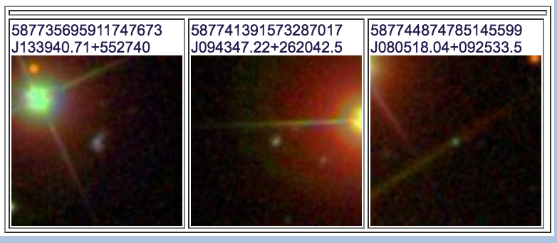
8 from Original 80 not recovered
3 BAD photometry – near bright objects….
2 not in Portsmouth Catalog
3 had EW < 0.5
15 Not classified as ‘Star Forming’ in BPT
(Seyfert, Composite, LINER)

Slide 10
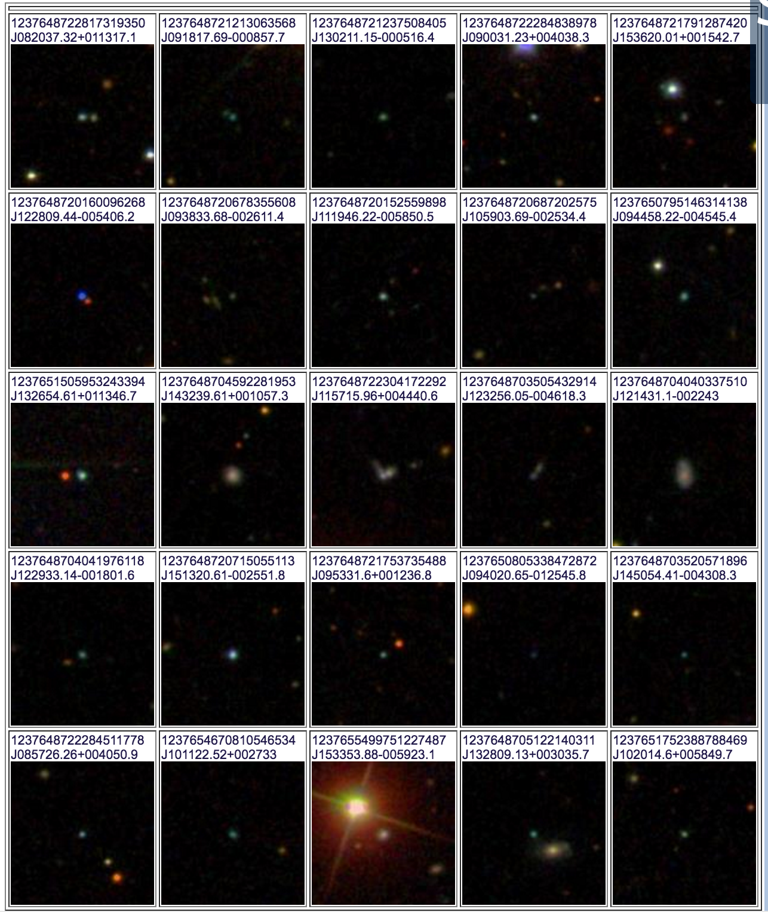
Images of DR 12 Peas Stripe 82

Slide 11
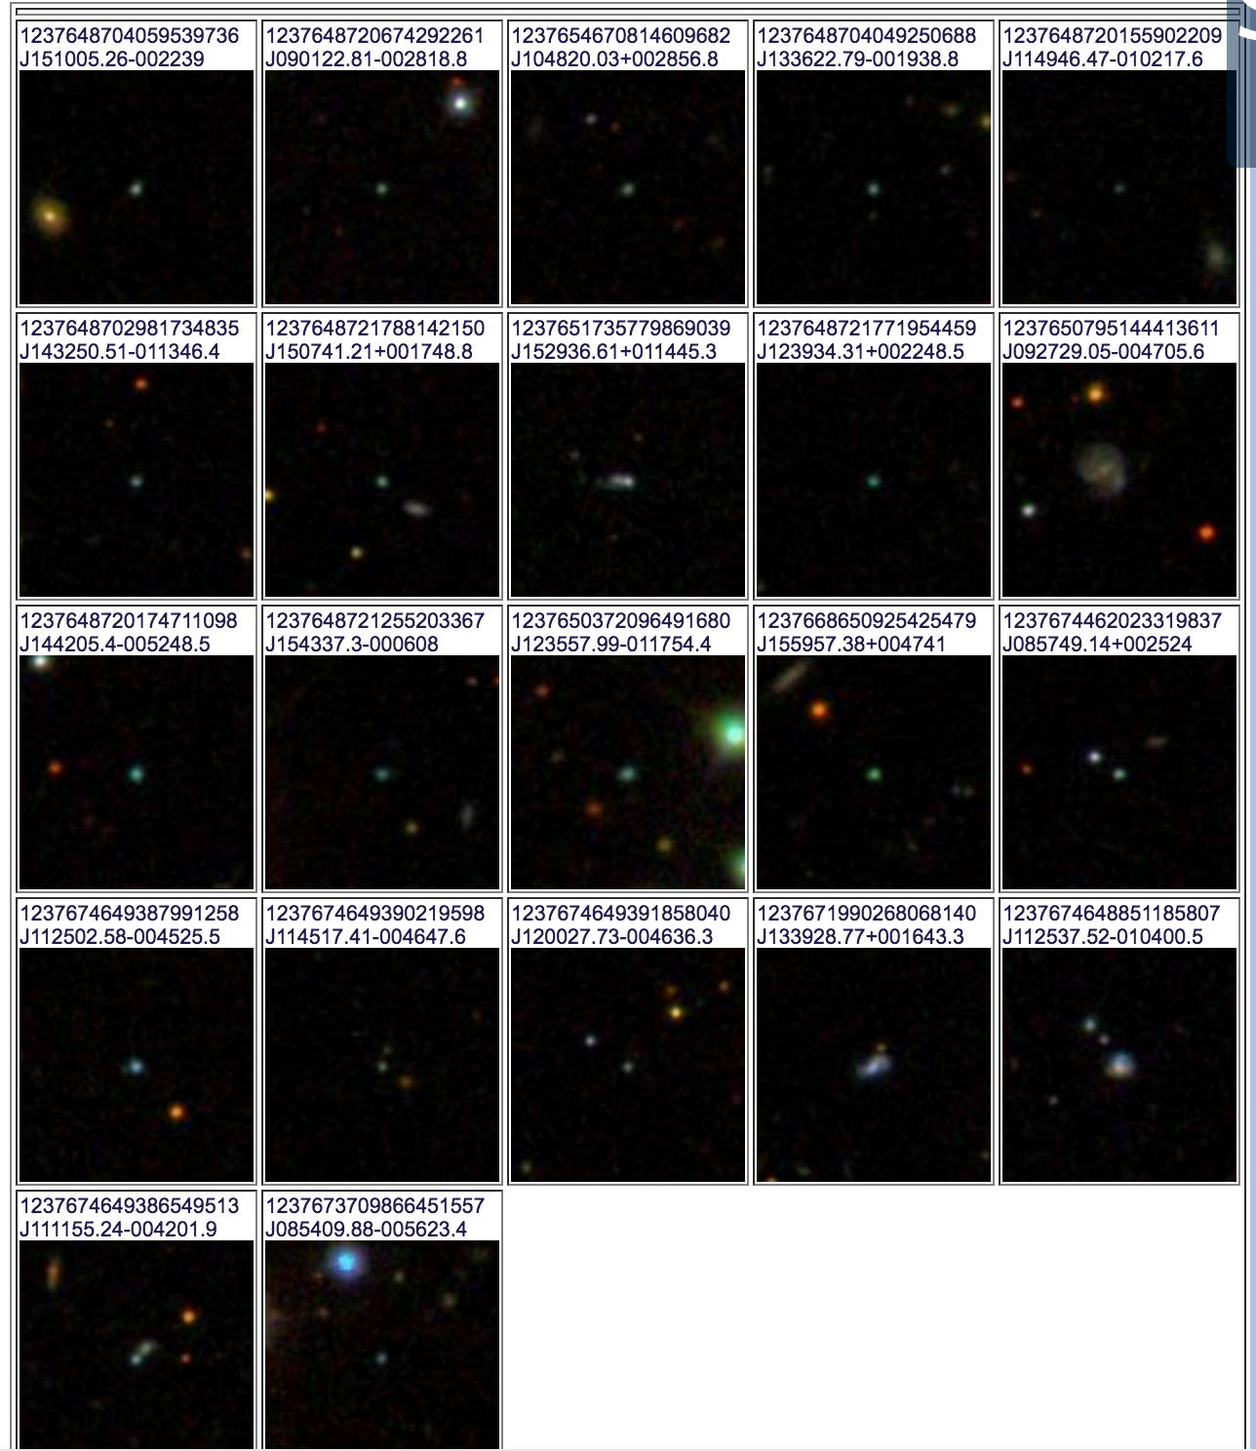
Images of peas Stripe 82

Slide 12
